Slide 1
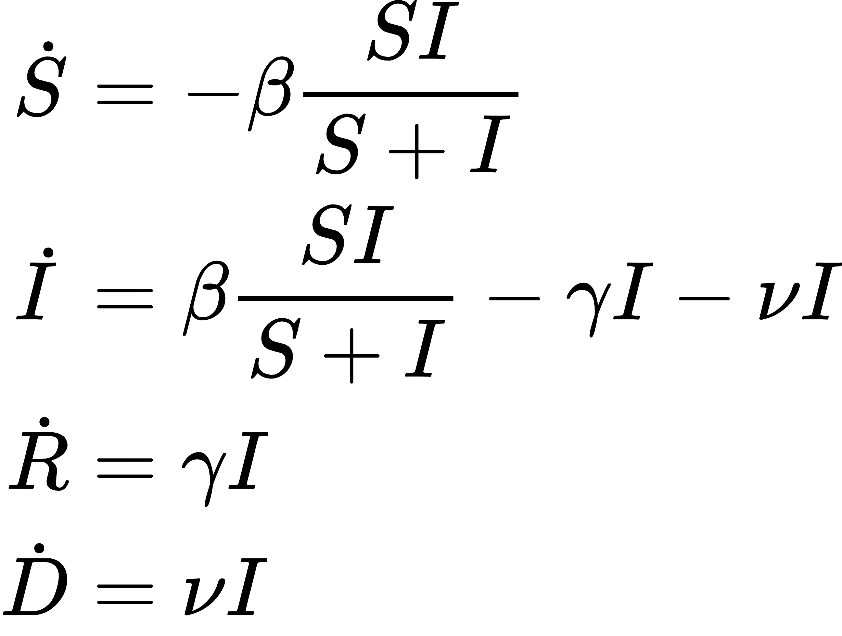
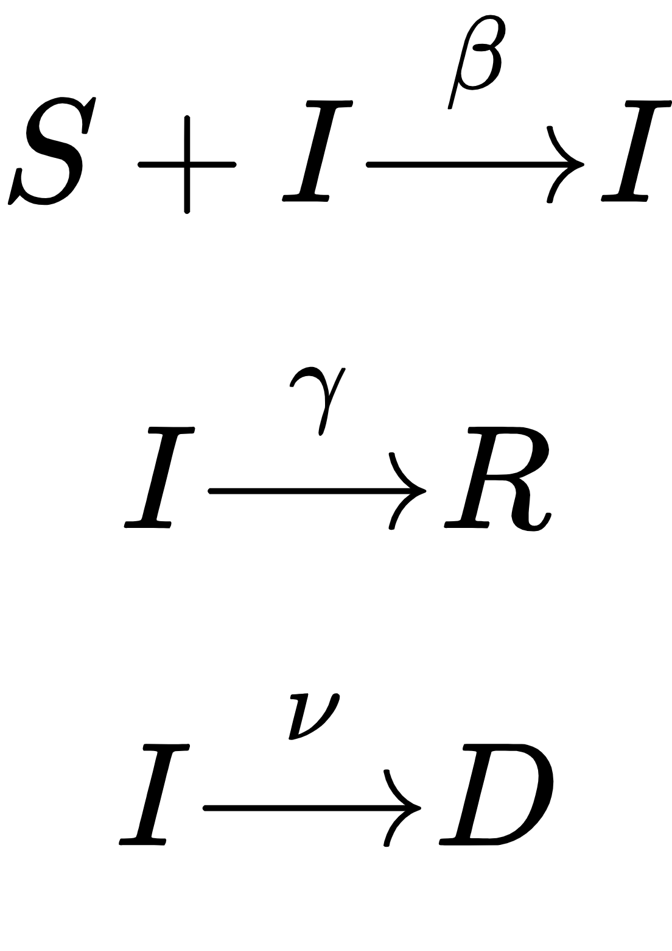
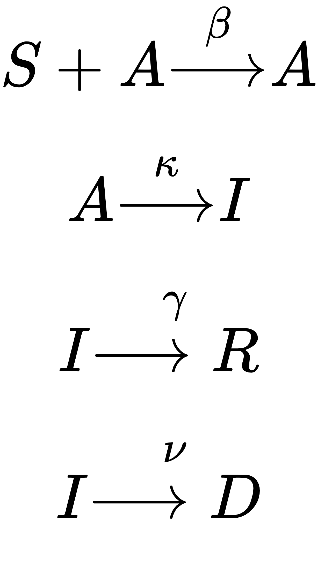
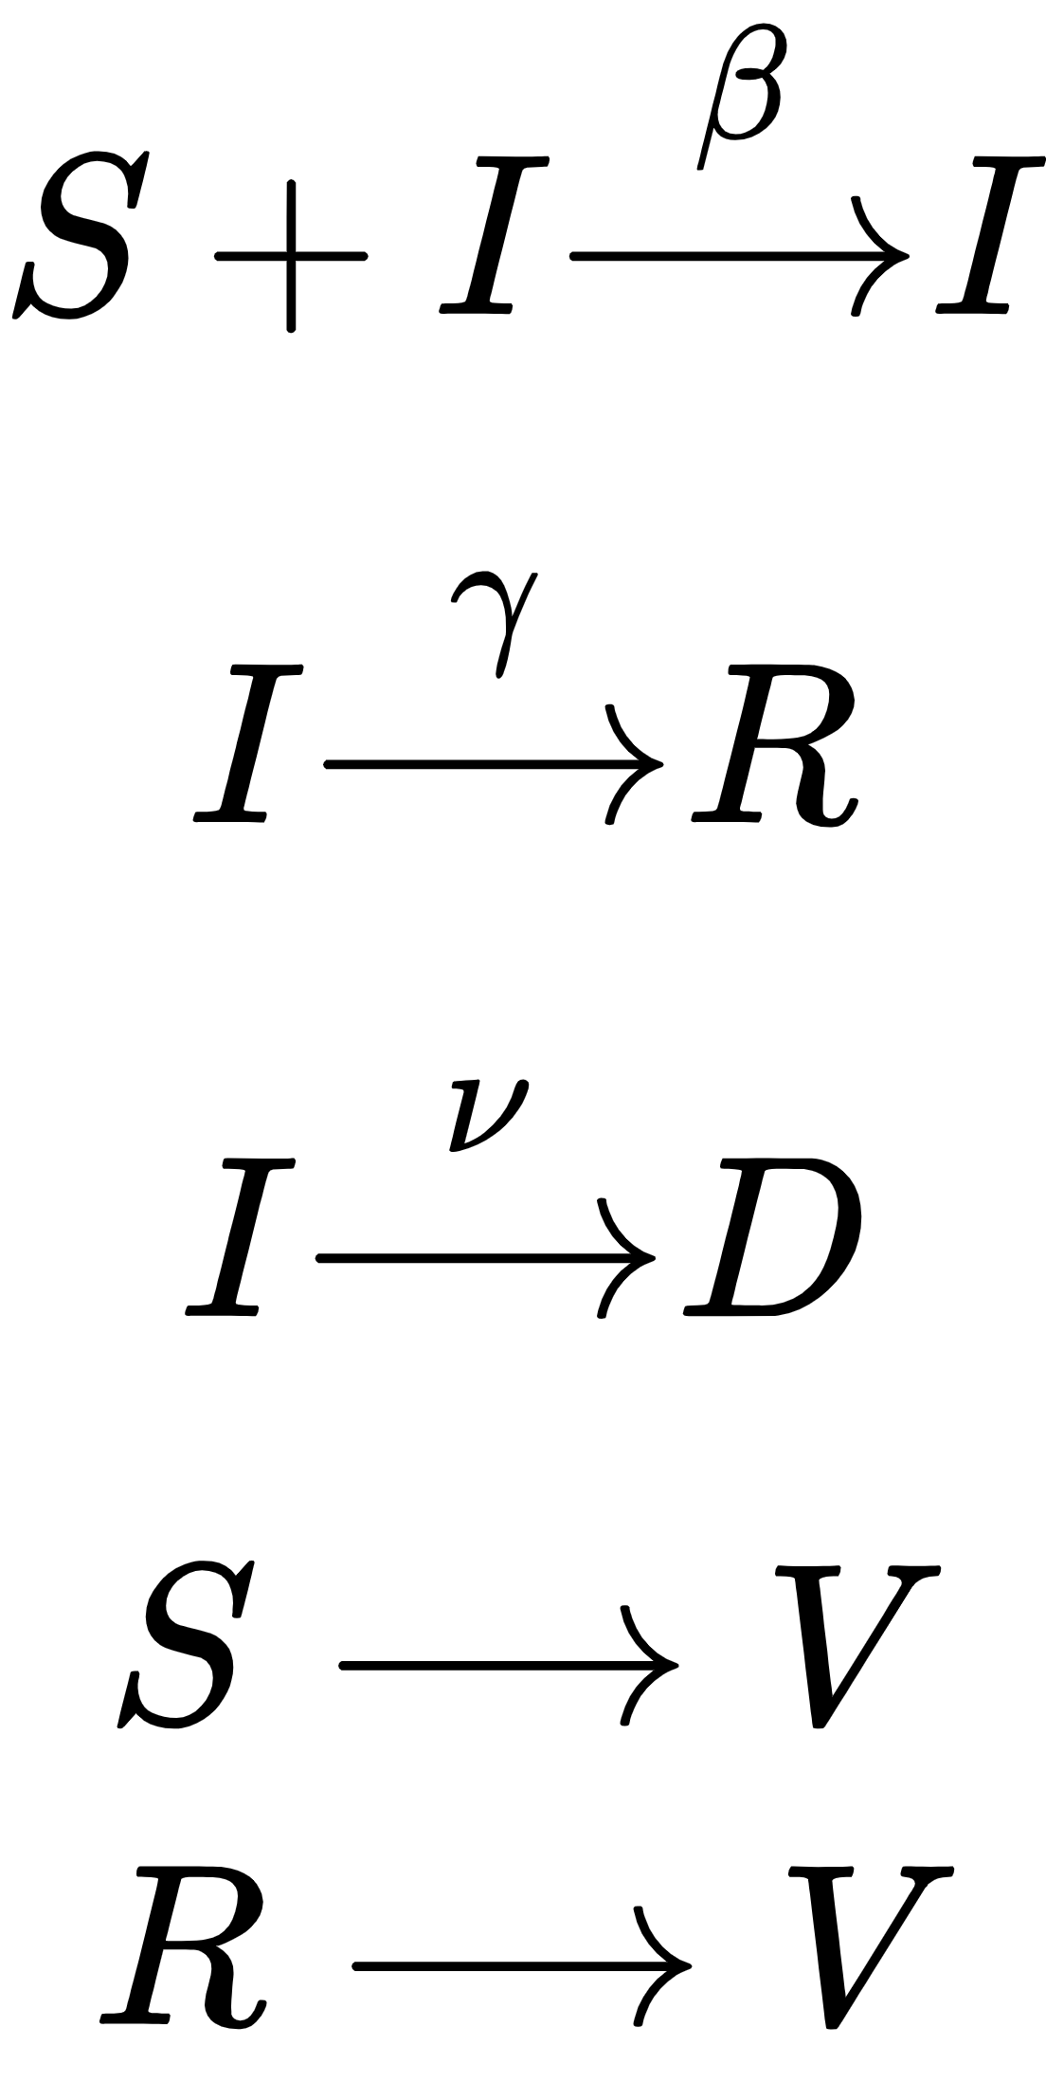
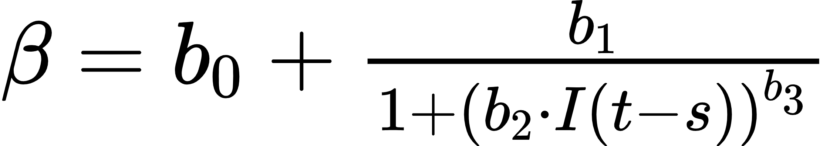
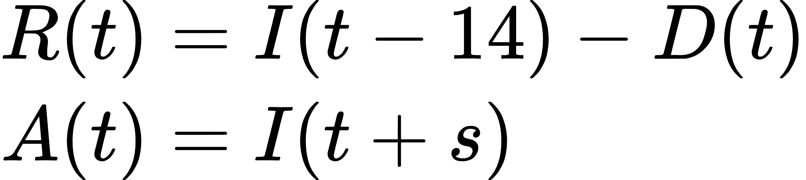
Using Feedback and Vaccination Data to More Accurately Model and Predict the SARS-CoV-2 Pandemic Daniel March, Jeston Bond, Gentian Buzi Department of Math and Computer Science, Biola University
Abstract
We compare the predictive power of several different disease models and their ability to model the transmission, recovery and death rates. The simplest disease model tracks the susceptible, infected, recovered, and dead populations over time (SIRD). We additionally use a model incorporating asymptomatic individuals (SAIRD) and add a degree of feedback to these models to better track the transmission rate. The inclusion of feedback enables the model to predict minor outbreak spikes, which is a major advantage over the basic SIRD model.
Models
SIRD:
The SIRD model
--
SAIRD:
SIRD+V:
Feedback SIRD:
This model is identical to the SIRD model except for the transmission rate parameter, β. Beta is replaced with a time varying function depending on the current infections with a shift, s (typically s=14). The nature of β is that in times high infections, the transmission rate will decrease after some delay and then rise back again when infections have decreased.
Feedback SAIRD:
Results
Modeling Transmission Rate in Italy and California:
Predicting first wave decline:
Predicting first wave:
Predicting late-stage wave:
Data
The data for this project was extracted from publicly available databases. For US data, numbers for daily total infections, deaths, and vaccinations was acquired from the CDC. For Italian data, numbers for current infections, recoveries, and death were acquired from the Italian Department of Civil Protection.
Methods/Approach
Due to the nature of the data, not all infections, recoveries, and deaths are recorded. Therefore, a scaling factor to I, R, D must be used to properly model these populations. This value, q, is solved by gridding values and minimizing an objective function.
Some additional populations must be approximated since these values aren’t always reported. The recovered and asymptomatic populations can be approximated using the below equations. Note that S,A,I,R,D are time series.
Conclusion
References

